Slide 1
Manitoba Wildfire Prediction Dashboard

Slide 2
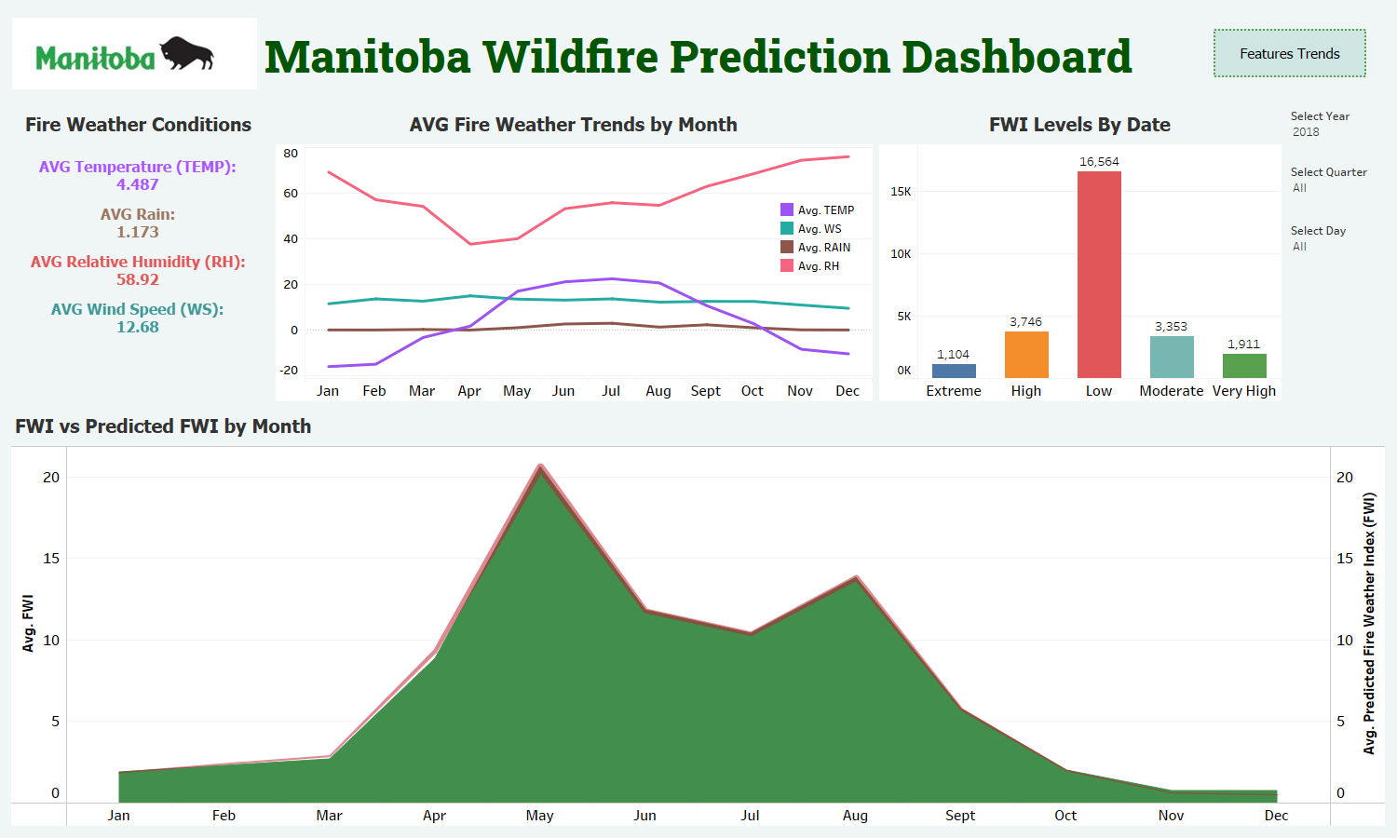

Slide 3
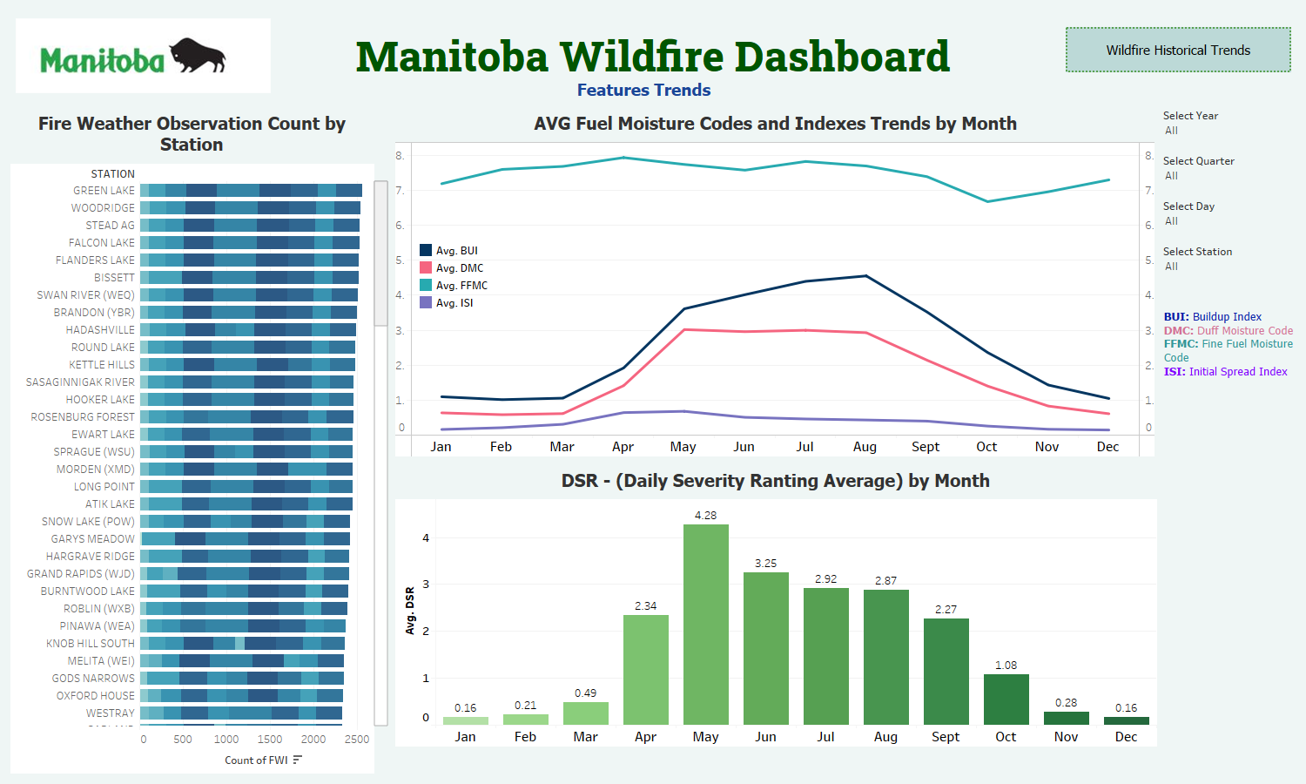

Slide 4
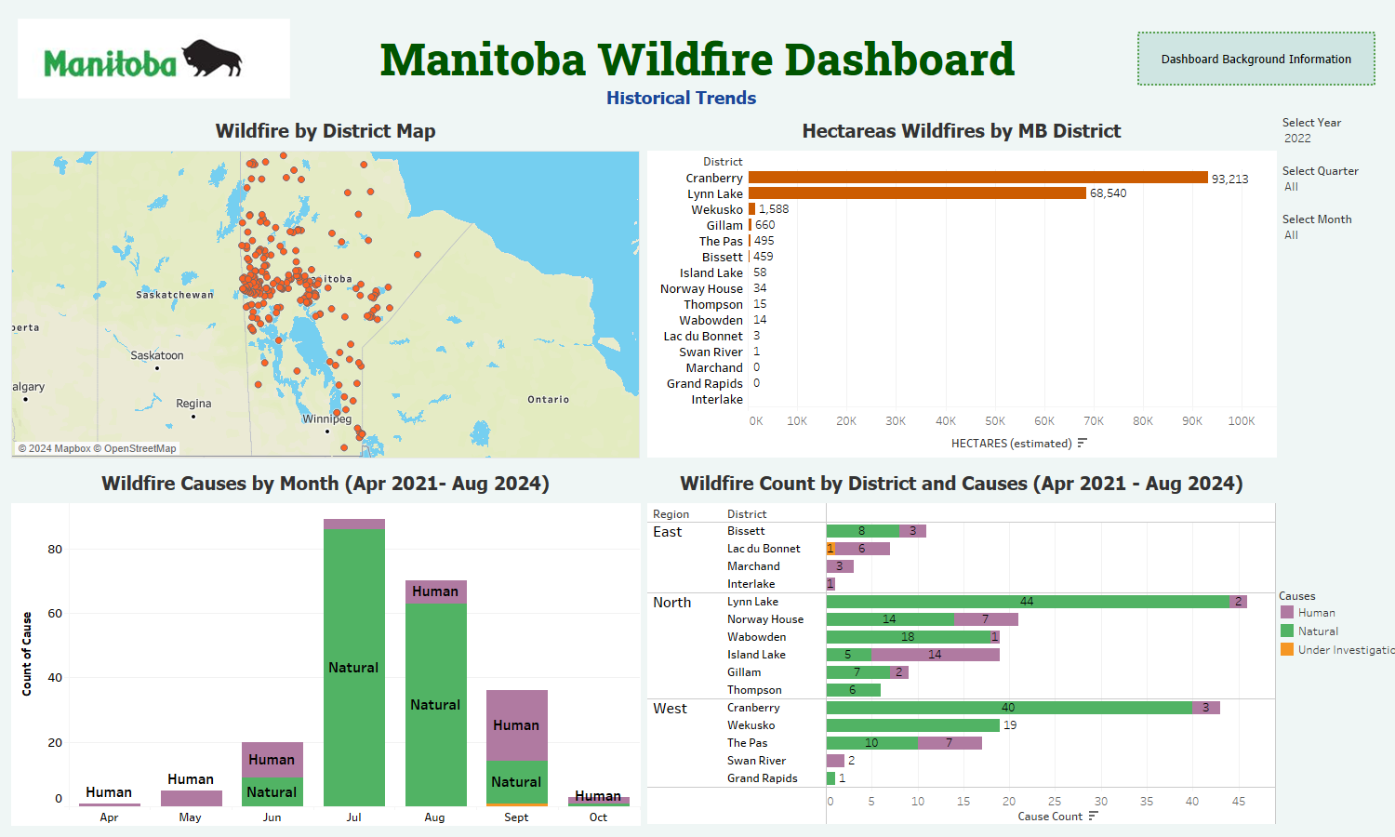

Slide 5
